Slide 1
Online Patient Registration System

Slide 2
Group Member
1
2
3
4
Ernest Tete Mensah
Prosper Kofi Legbedze
Obed Kaburi
Abraham Nkrumah

Slide 3

Problem Statement
The manual registration of patients in clinics and hospitals is time-consuming and error-prone. It often leads to long queues, incomplete data, and a lack of real-time information.

Slide 4
Solution
The Online Patient Registration System automates the registration process, enabling patients to register online, book appointments, and update personal information, while admins and doctors can manage patient records efficiently

Slide 5
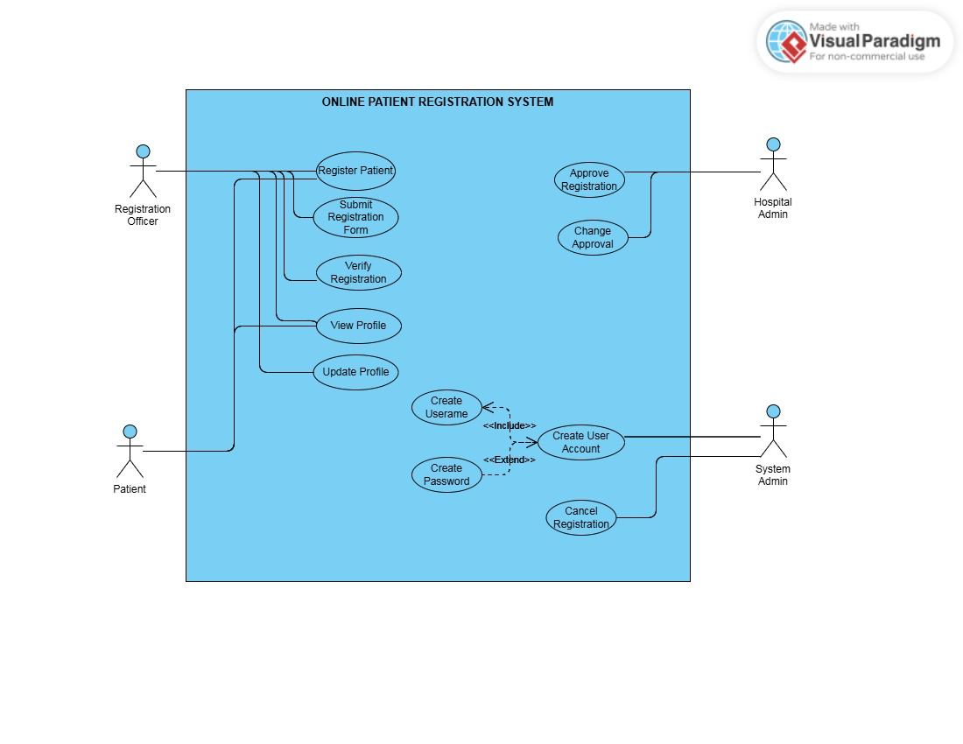
UML USE CASE DIAGRAM

Slide 6
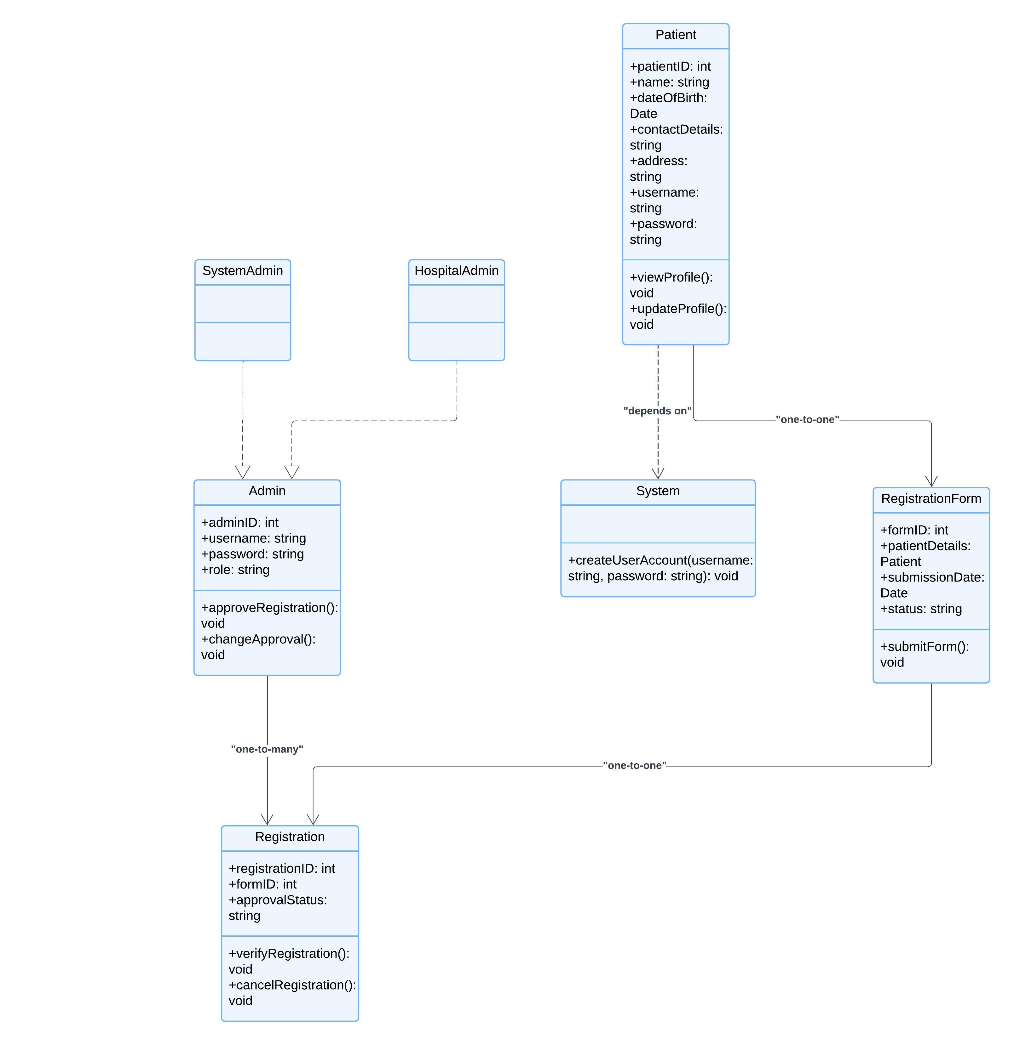
UML CLASS DIAGRAM

Slide 7
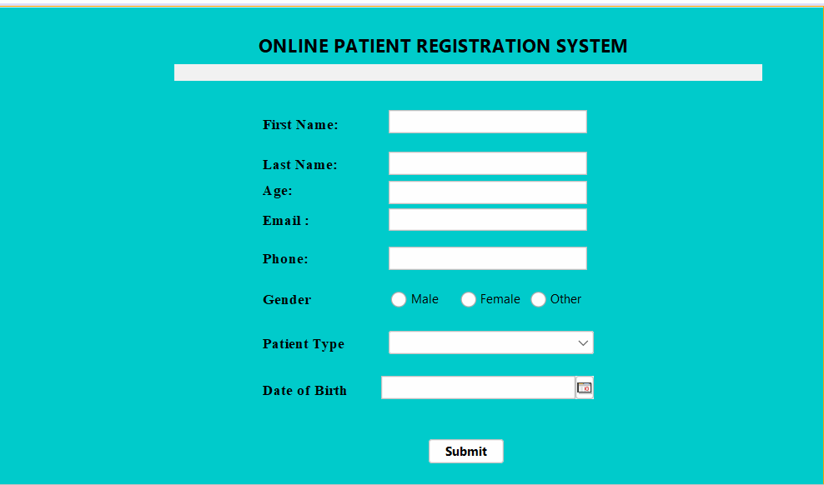
REGISTERATION FORM

Slide 8
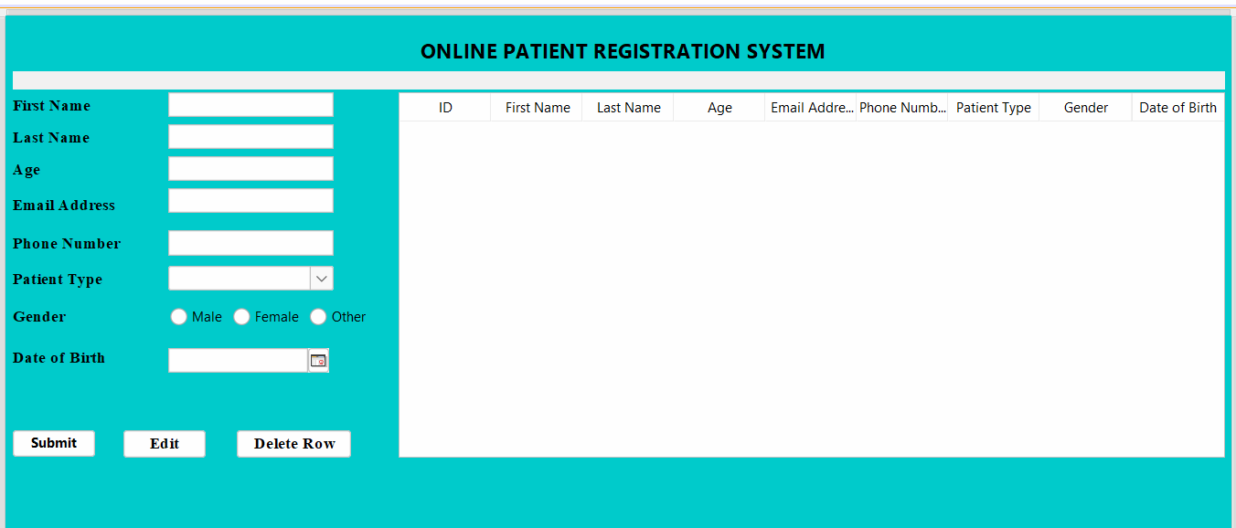
VIEW

Slide 9
Thank you

